Slide 1
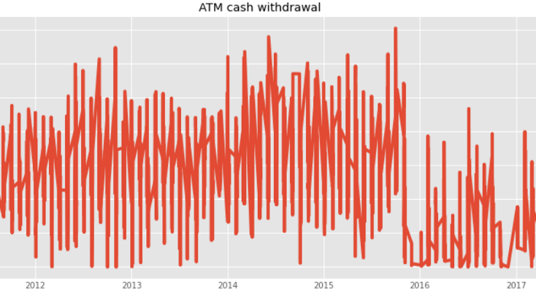
Project: ATM Cash Predictor
Group Member:
Muhammad Owais Mushtaq (18K-1177)
Muhammad Usman Umar (18K-1069)
Shaharyar Amjad (18K-1371)

Slide 2
What is ATM Cash Prediction? Why it's needed?
Cash demand in ATMs require accurate prediction.
If the forecast is wrong, it induces a considerable amount of costs.
In the case of high forecast and high unused cash stored in the ATM costs to the bank.
Banks pays a significant amount of fixed fees for the refilling, additional cost for the transportation.
Some bank store more cash than their actual demand. These ATM machine may be situated in center of the city or busy area.

Slide 3
Business criteria in ATM forecast
ATM should not be filled with large amount of cash which may bring low transport/logistic cost but high freezing and high insurrance costs.

Slide 4
Our Objective and its solution
As daily cash withdrawal amounts are time series.
Therefore in this ATM cash forecast models we have train dataset of ATM machine with time series and regression machine learning models to troubleshoot the above use case.
We have work on 2 dataset of multiple ATM machine in their particular area which we got from kaggle website.

Slide 5
Modelling Daily Cash Demand
We have tried fitting several time series as according to our course which we have studied and which we have better knowledge.
As this ATM Cash forecast is FYP level project.
As we have trained 2 dataset.
On 1st dataset we have applied 2 models that are Linear Regression and XGB Boost.
On 2nd dataset we have used only Linear Regression
As there are many but out of course content.
In this 2 dataset there are both numerical and categorical variables.

Slide 6
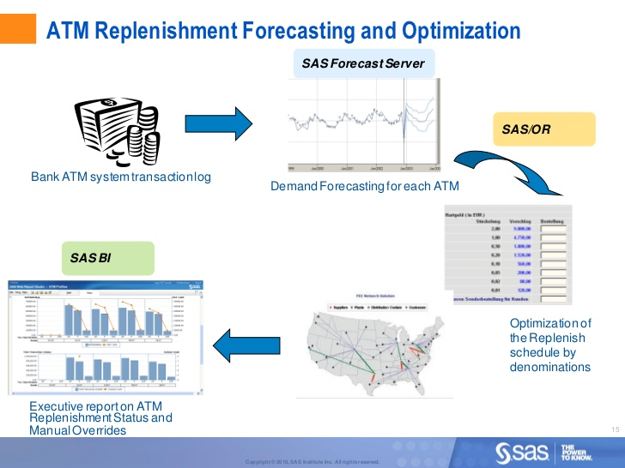
How ATM Replenishment Forecasting and Optimization?

Slide 7
Further details are...

Slide 8
Results
As we have work on two datasets
Aggregated.csv
Atm_data_m2.csv
On Aggregated.csv dataset we got 100% accuracy and variance 1.0 by linear regression so we didn’t applied XGB Boost model.
While on atm_data_m2.csv file we got nearby 164% accuracy prediction but it was too large amount which was put inside ATM machine so we applied XGB Boost.

Slide 9
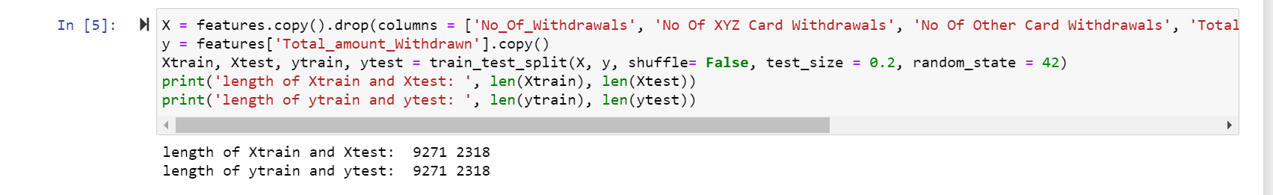
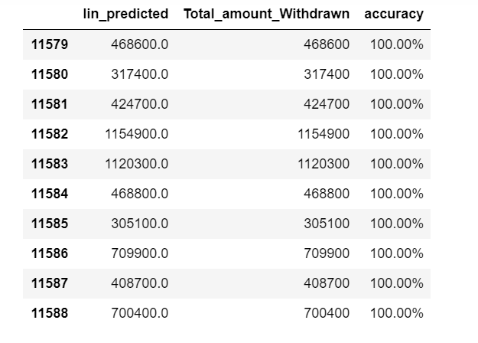
Dataset: Aggregated.csv by Linear Regression

Slide 10
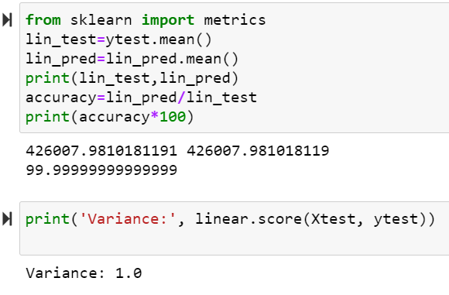

Slide 11
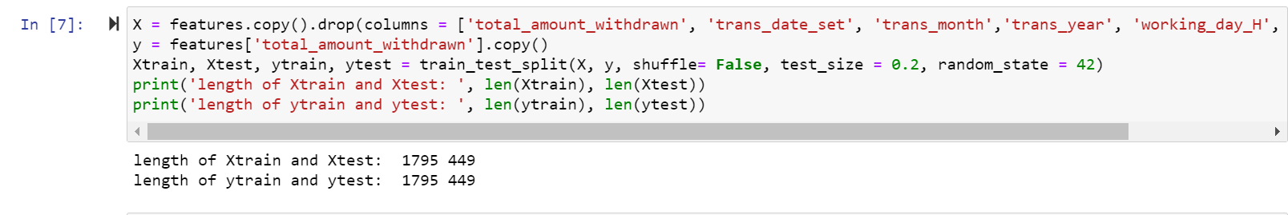
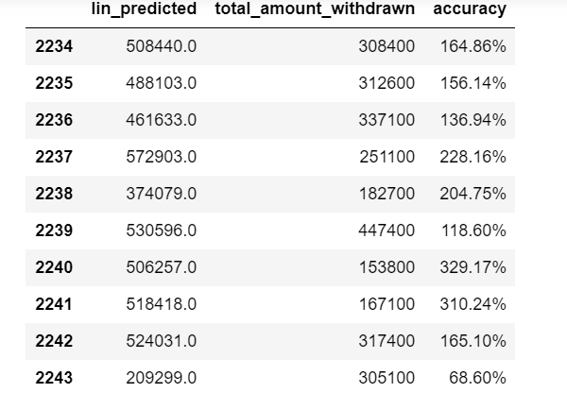
Dataset: atm_data_m2.csv we applied(Linear Regression and XGB Boost)

Slide 12
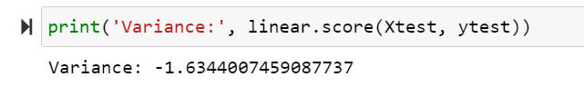
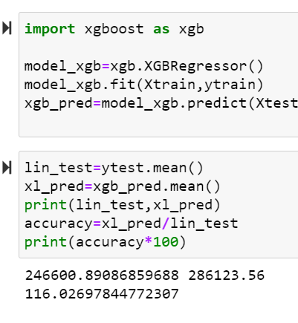

Slide 13
Reasons
As the results of atm_data_m2.csv are not perfect in prediction and due not available of too much dataset we didn’t train more.

Slide 14
Any Question?

Slide 15
Thank YOU!

